Slide 1
Machine Learning on Stock Market Data
Team Members:
Khushbu Parekh
Tapadyuti Maiti

Slide 2

Problem Statement
Stock Prices are totally random and unpredictable
Its volatile in nature
Foresee whether tomorrow’s exchange closing price is going to be lower or higher with respect to today
The successful prediction of a stock's future price could yield significant profit.

Slide 3

The solution
Model the Top 5 Companiesand DOW 30 and Predict future Stock Prices based on our Models.
Linear Regression , Random Forest , KNN with Neural Network
Sentiment Analysis from the Twitter Data for all the DOW 30 , and selected companies

Slide 4
1.Data Ingestion
We are taking the data from the YAHOO Finance as the Financial Data, from the Reddit TOP News and Twitter Feeds as input for performing sentiment Analysis.
Yahoo Finance
Twitter Data for Specific Stock Ticker
Google Trends
Link for Data 2005 - 2017
Yahoo Finance Data
Reddit News
Python Package : tweepy

Slide 5
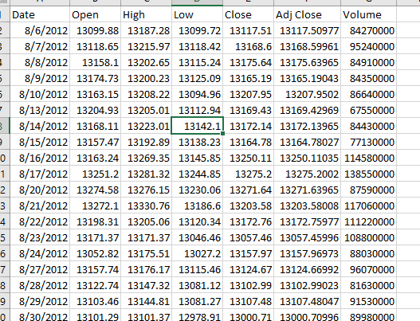
Sample Dataset :
Date : Date of Stock Exchange Operation
Open :The price of the first trade for any listed stock is its daily opening price(USD$)
High: Highest price at which a stock traded during the course of the day (in US dollars)
Low: Lowest price at which a stock traded during the course of the day (in US dollars)
Adjusted Close: price of the stock at the closing of the trading adjusted with dividends (in US dollars)
Volume: Total Number of a security that were traded during a given period of time

Slide 6
Tools
•Python – Data processing and Machine Learning Algorithm
•Docker – For easy distribution and submission.
•Python – Web application, REST API.
•Amazon – EC2, S3.

Slide 7

Web Application

Slide 8
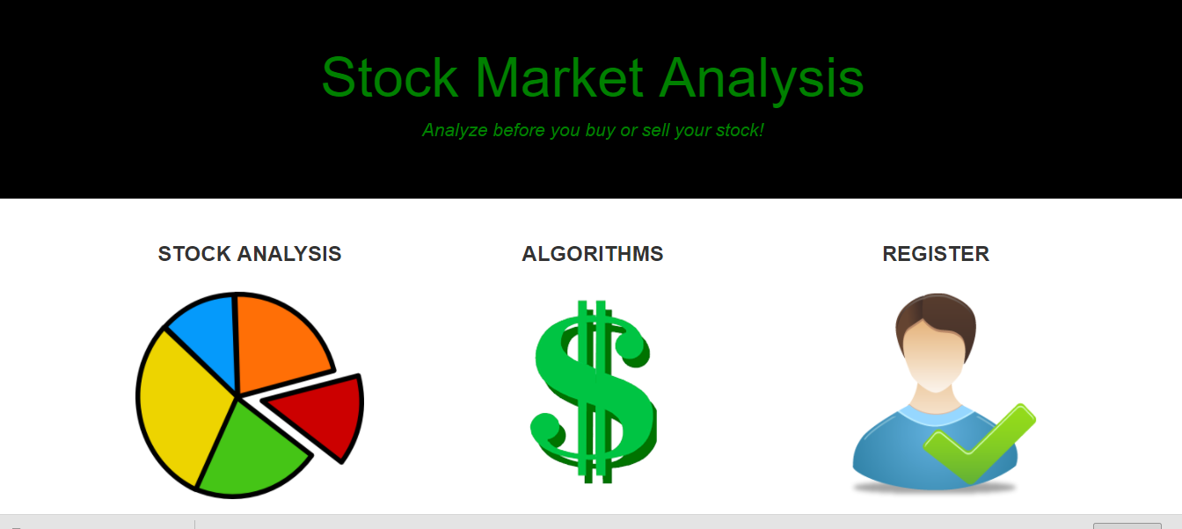

Slide 9
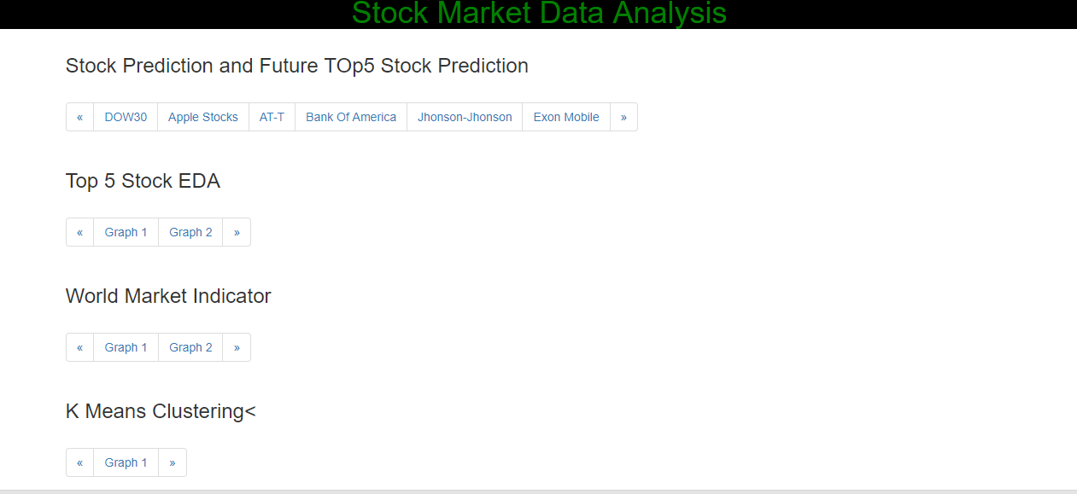

Slide 10
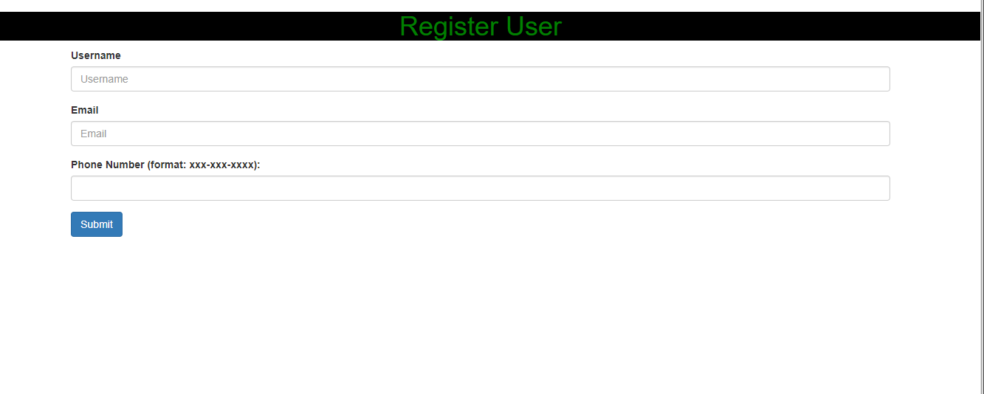

Slide 11

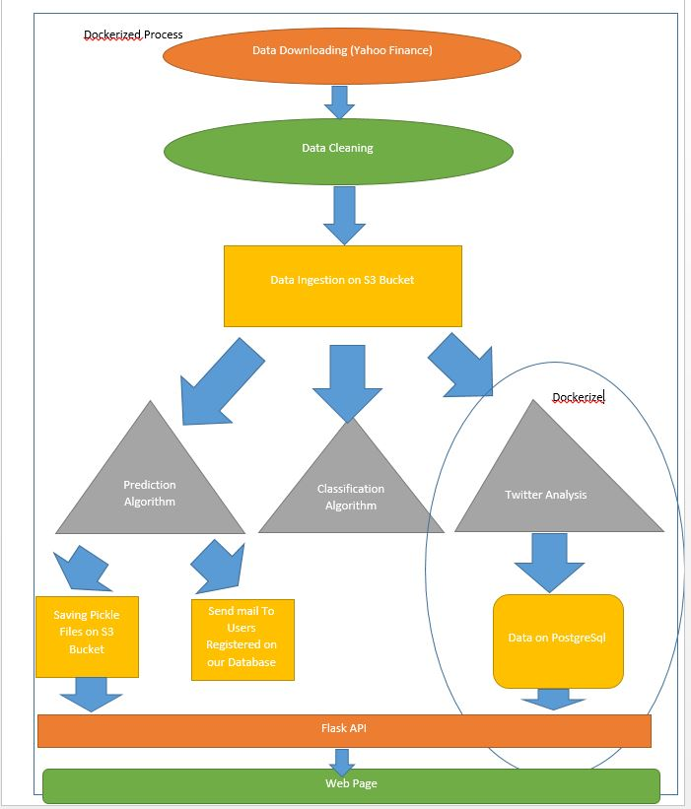
System Architecture
Data Ingestion
Data Wrangling
Clean Data on S3
Modelling the data - ML
Web App using Rest API

Slide 12
Youtube link: https://youtu.be/LETQ6bjLGhQ

Slide 13
Thank You !

